Slide 1
Fitness Buddy An AI FITNESS COACH FOR WORKOUTS,MEALS AND motivation-Anytime
IBM HACKATHON PROJECT
Presented By:
Student name : Meka Hamsa Gayathri
College Name & Department : Presidency University & CSE

Slide 2
OUTLINE
Problem Statement
Technology used
Wow factor
End users
Result
Conclusion
Git-hub Link
Future scope
IBM Certifications

Slide 3
Problem Statement
In today's fast-paced world, many people struggle to maintain a healthy lifestyle due to time constraints, lack of motivation, and the absence of personalized guidance. Traditional fitness solutions are often costly, rigid, or inaccessible. Fitness Buddy aims to address this by offering a friendly, conversational AI assistant that provides personalized workout routines, motivational tips, and basic nutrition suggestions anytime, anywhere.
Proposed Solution :
To address the growing demand for accessible and personalized fitness guidance, we propose Fitness Buddy—an AI-powered virtual assistant built using IBM Granite and deployed on IBM Cloud Lite. This intelligent chatbot acts as a 24/7 fitness companion, providing:
Customized home workouts based on user goals, fitness level, and time availability.
Simple and nutritious meal suggestions using AI-driven responses.
Motivational tips and habit-building reminders to keep users on track.
On-demand access—no scheduling, no subscription, no physical presence required.

Slide 4
Technology used
IBM Granite Model (Granite-3-3-8b-instruct) :
Used as the core Large Language Model (LLM) to generate intelligent, personalized fitness and nutrition responses in a conversational tone.
Watsonx.ai Prompt Lab:
Deployed the agent using structured chat with custom instructions and quick start questions for user engagement.
IBM Cloud Lite:
Utilized to host and deploy the solution without additional cost, leveraging its cloud environment for managing the AI agent securely.
Tools Used :
Depending on needs, additional tools like Tavily Search or Wikipedia Search can be integrated for real-time updates and knowledge retrieval.

Slide 5
IBM cloud services used
IBM Cloud Watsonx.ai Studio – for building and managing AI models
IBM Cloud Watsonx.ai Runtime – for executing the models/agents
IBM Agent Lab (Prompt Lab) – for creating, testing, and deploying your AI agent
IBM Granite Foundation Model – as the LLM behind the agent's intelligence
IBM Identity & Access Management (IAM) – for API key and secure access
IBM Deployment Space – for deploying the Python interpreter or tools

Slide 6
Wow Factors for Fitness Buddy Agent:
Fitness Buddy stands out as an intelligent, user-friendly virtual coach designed to make healthy living easier, more personalized, and accessible for everyone.
Conversational AI coach that provides personalized fitness guidance through natural interactions.
Recommends home workout routines based on user preferences, without the need for a gym or equipment.
Suggests simple and nutritious meal ideas tailored to user needs.
Sends motivational messages, daily reminders, and habit-building suggestions to encourage consistency.
Offers flexible, on-demand support that fits into any schedule, saving time and effort.
Utilizes IBM Granite (LLM) and Watsonx for intelligent, adaptive, and empathetic responses.
Enhances user engagement by acting like a virtual fitness companion rather than a static chatbot.

Slide 7
End users
Health-conscious individuals
Busy professionals with limited time
Students aiming to stay fit at home
Beginners looking for guided workouts
People without access to gyms
Users seeking personalized fitness and nutrition tip

Slide 8
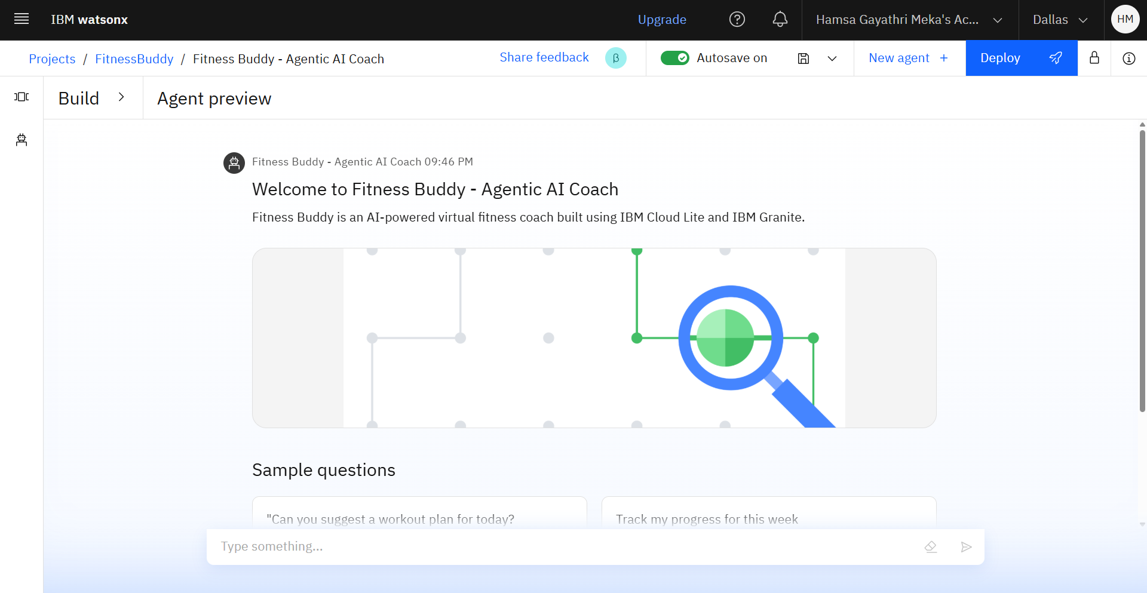
Results
The Fitness Buddy Agent was successfully developed and deployed using IBM Cloud Lite services and the Granite Foundation Model.
It was able to:
Respond to user queries with personalized fitness advice.
Recommend home workout routines based on input.
Provide healthy meal suggestions and motivational tips.
Adapt its responses to individual user needs through conversational interactions.

Slide 9
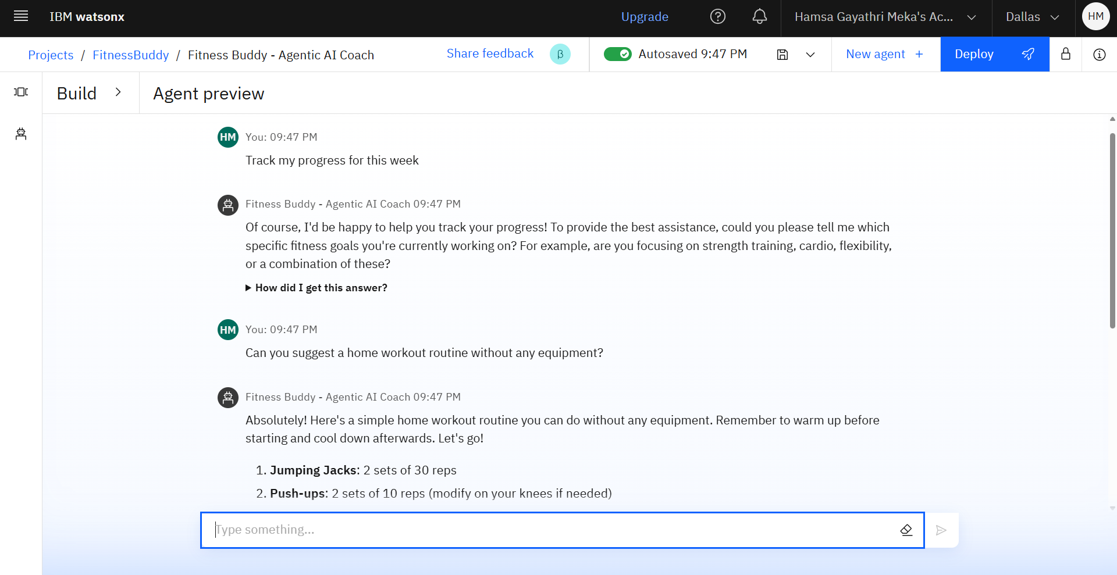
Results
In the preview, user tested the agent with two real-world queries:
🔹 “Track my fitness progress for this week.” The agent asked the needs.
🔹 “Can you Suggest a home workout routine without any equipment.” The agent recommended an effective bodyweight workout plan tailored to the user’s fitness level and time availability.

Slide 10
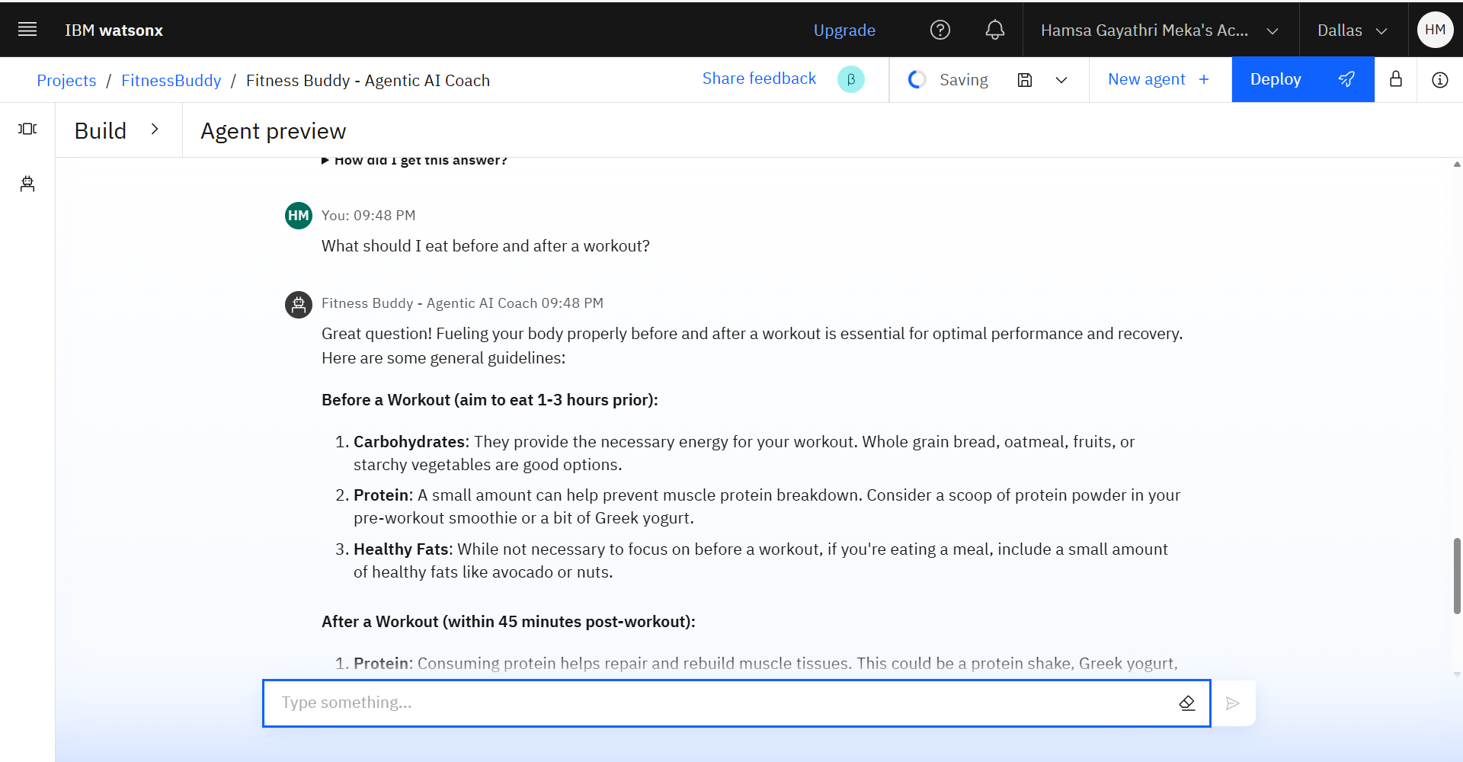
Results
To explore the assistant’s fitness guidance capability, the user asked :
“What should I eat before and after a workout?”
The agent gave practical nutrition tips, suggesting light carbs before a workout and protein-rich foods afterward to support recovery.

Slide 11
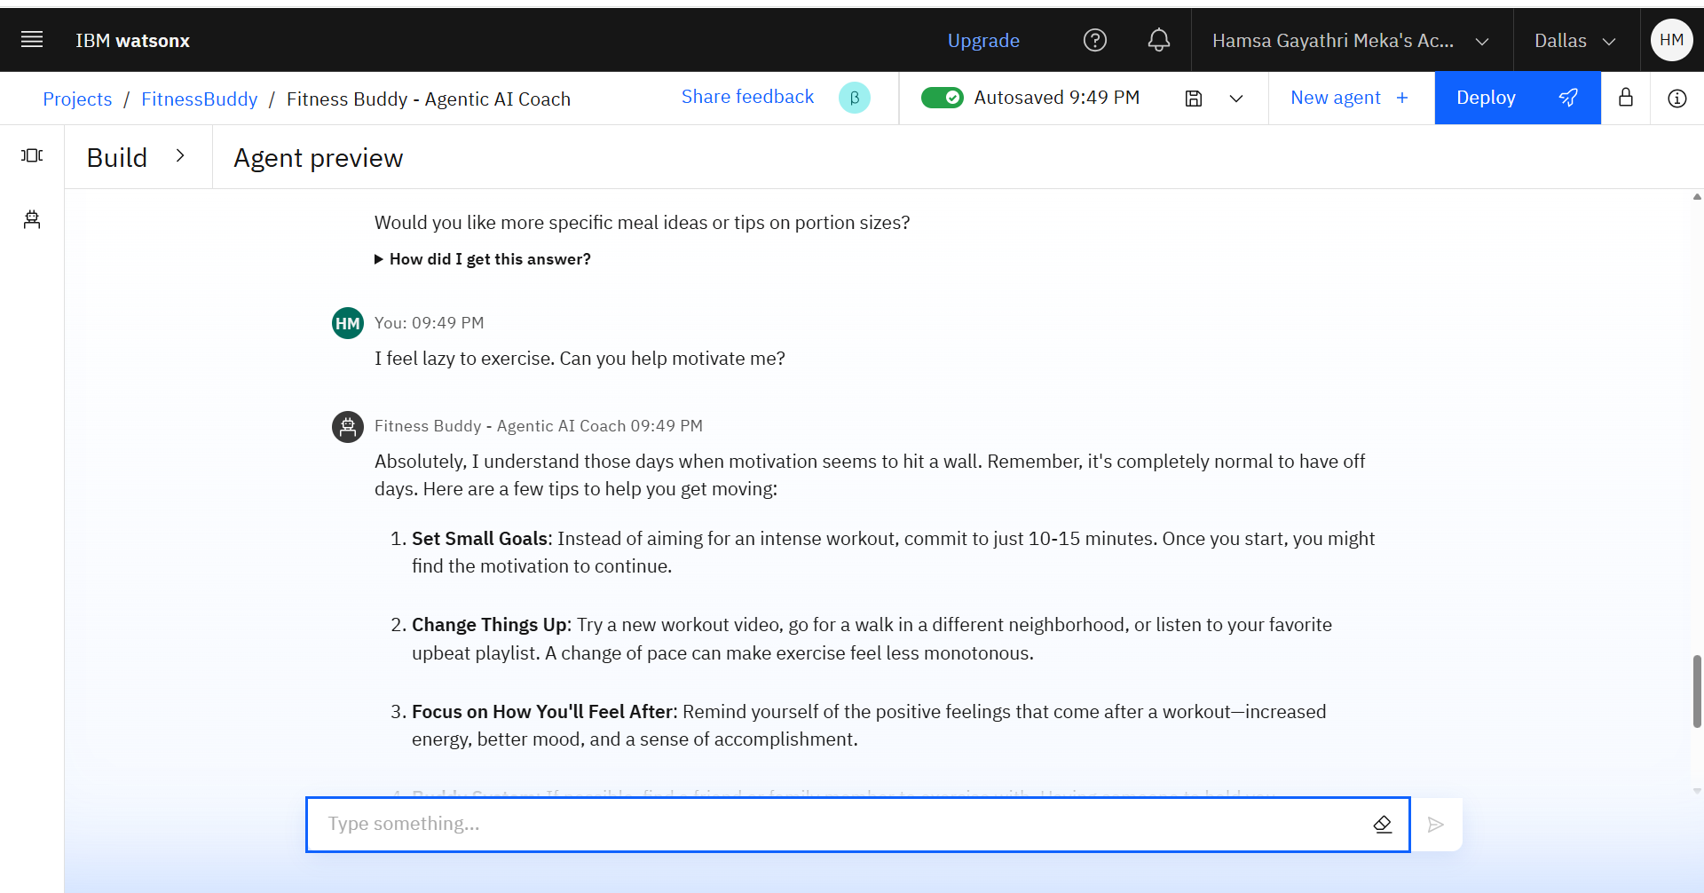
Results
User: “ I feel lazy, can you motivate me?”
The agent responds in an encouraging, friendly, and supportive tone. It offers small, achievable actions (like starting with light stretching) and uses positive language to boost motivation and make the user feel capable.

Slide 12
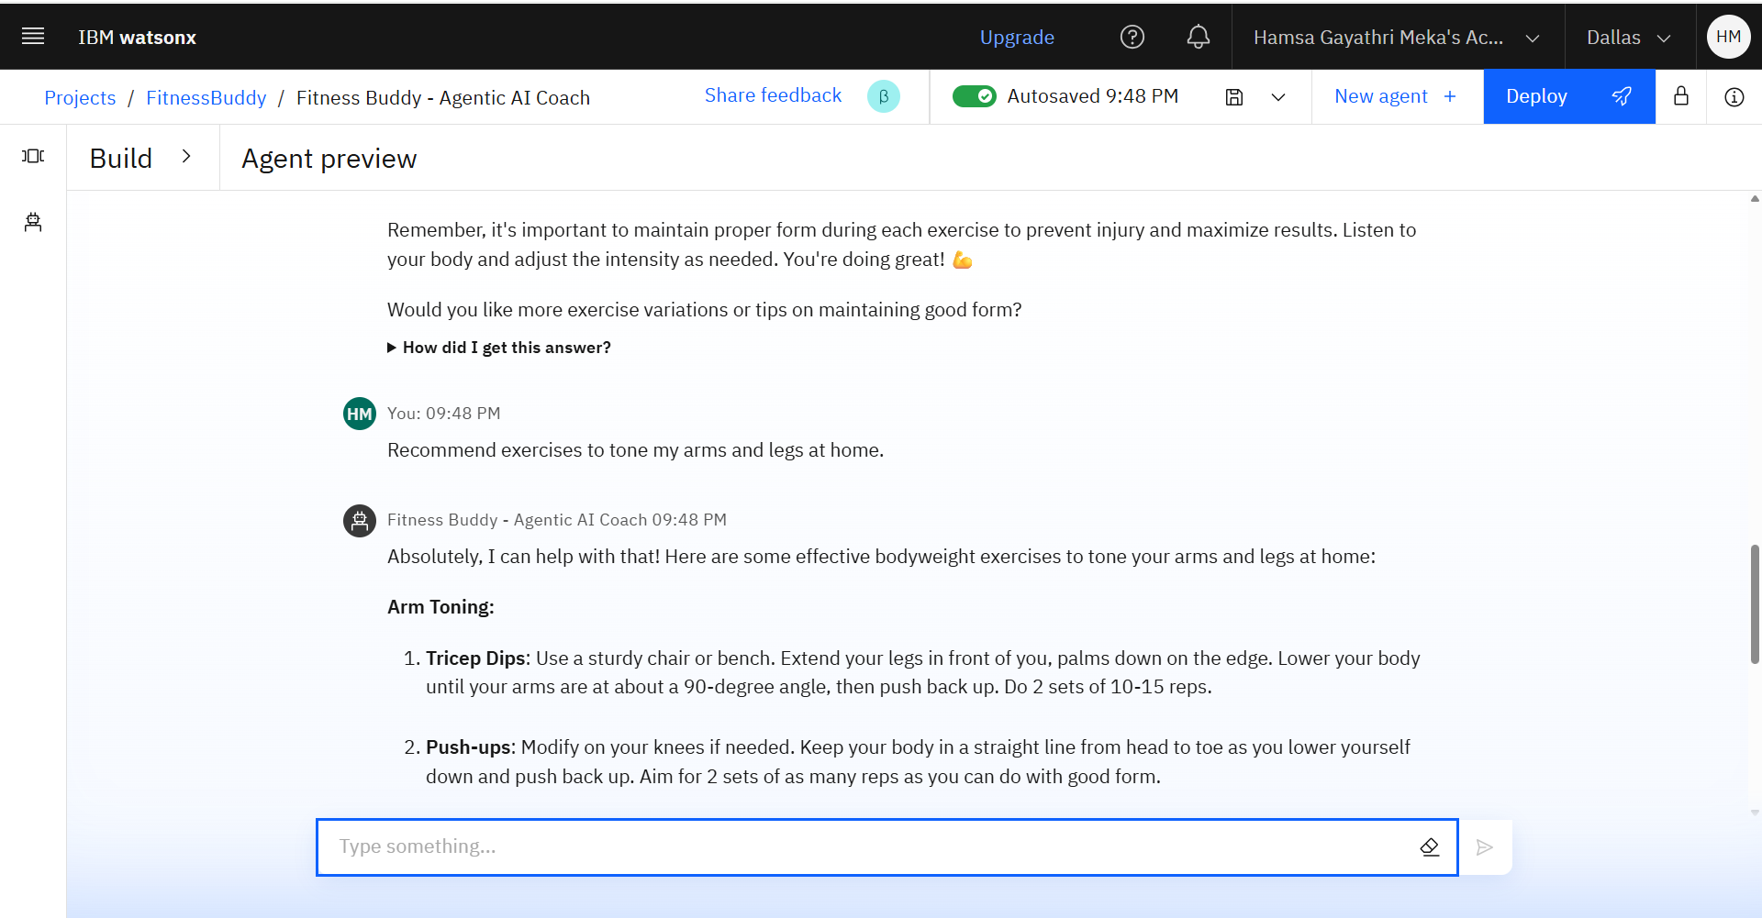
Results
user asks: “Recommend exercises to tone arms and legs at home”
Agent Behavior: The agent suggests beginner-friendly, no-equipment exercises like squats, lunges, push-ups, and tricep dips. It breaks routines into sets and reps, explains form clearly, and ensures the plan is easy to follow at home.

Slide 13
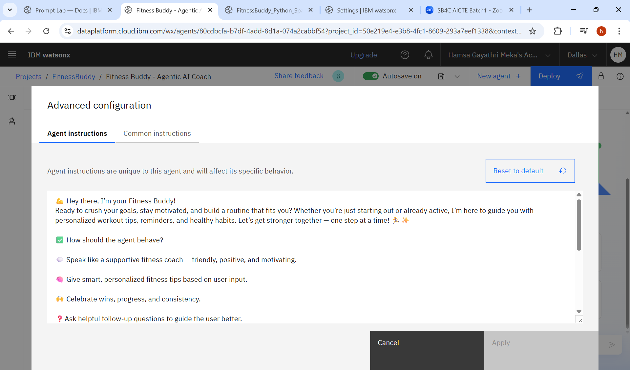
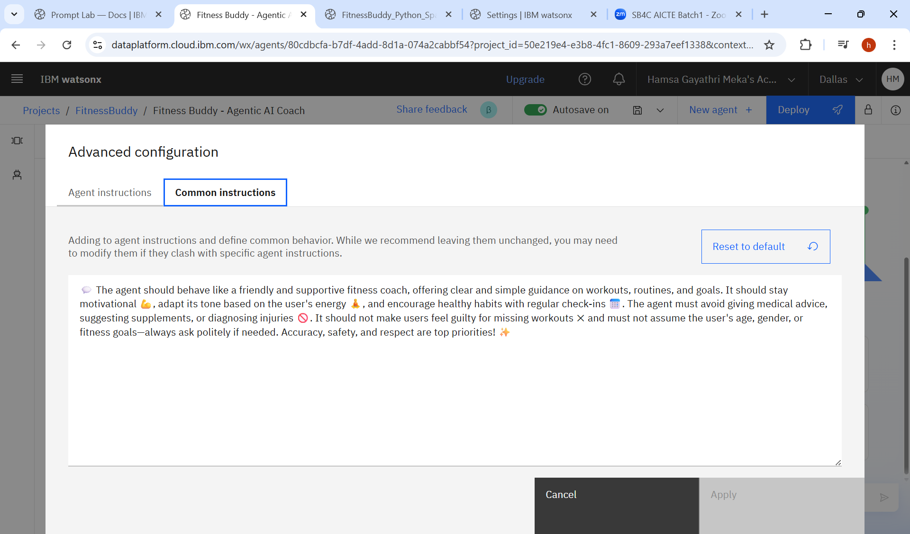
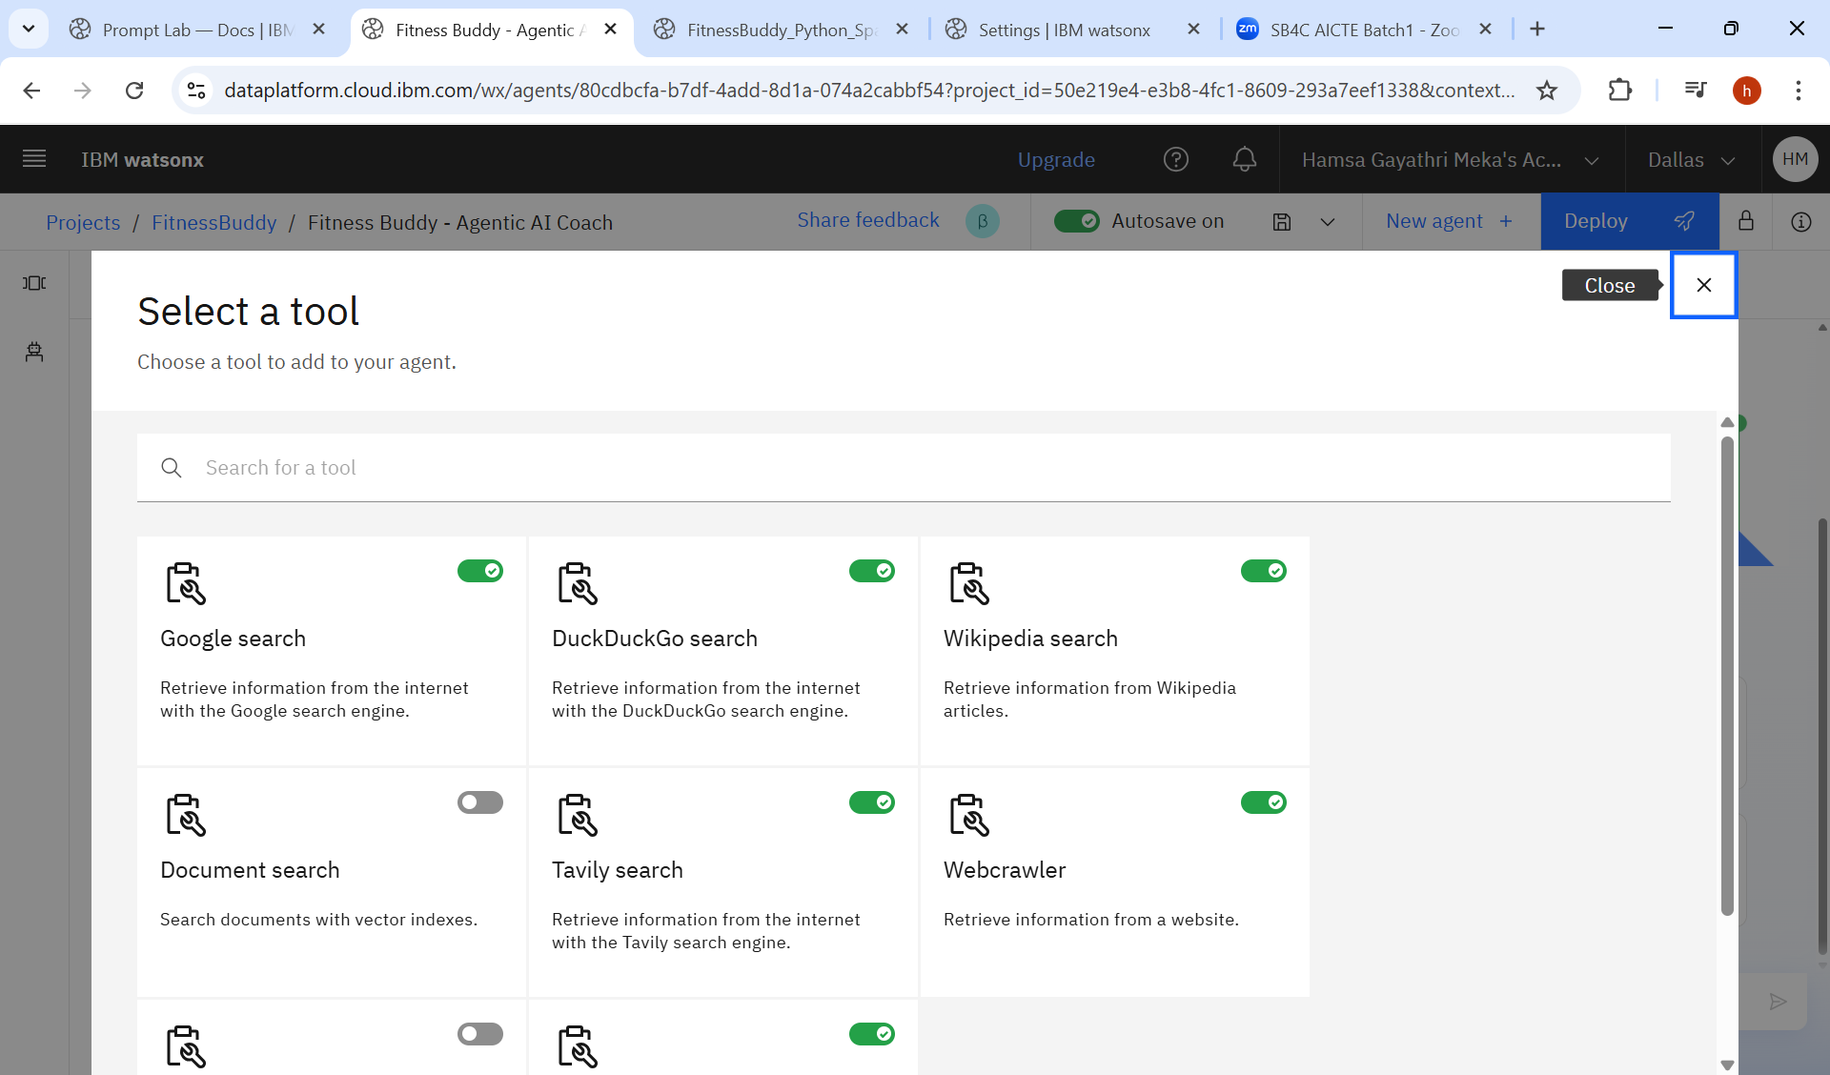
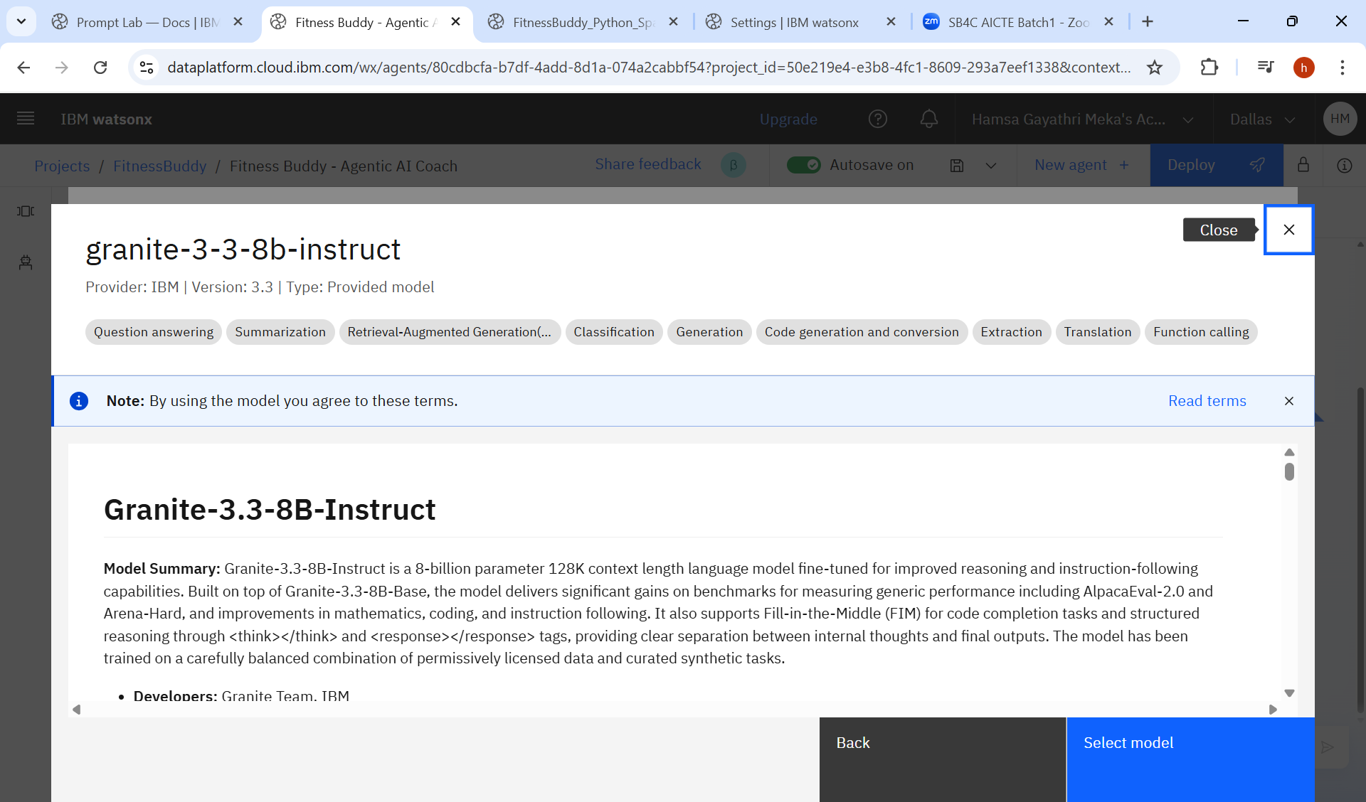
Screenshots of Setting Up the Fitness Buddy AI Agent

Slide 14
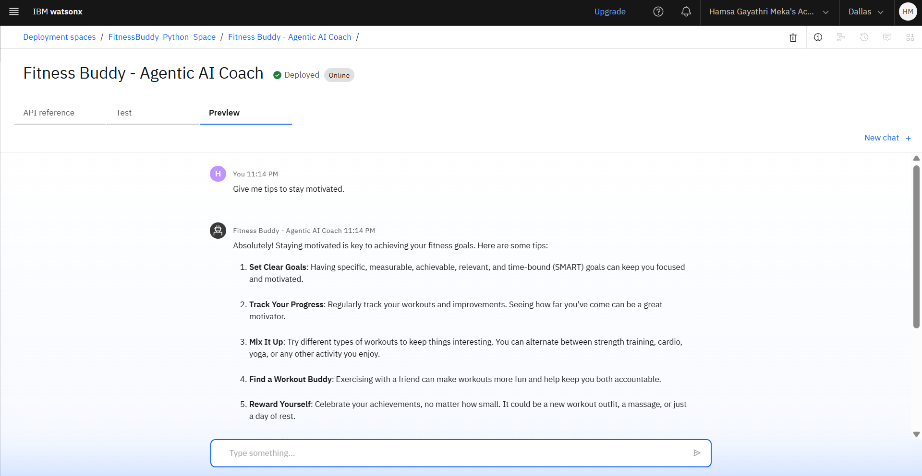
Results
Deployed AI Agent

Slide 15
Conclusion
The Fitness Buddy agent provides accessible, personalized fitness guidance for users anytime. It suggests effective home workouts, nutrition tips, and daily motivation—eliminating the need for costly subscriptions or rigid schedules. By promoting consistent, healthy habits, this AI-powered coach supports a balanced lifestyle and long-term well-being.
This conversational AI coach recommends home workouts, nutritious meal ideas, and motivating tips—all based on user input. Its friendly tone and flexible guidance help users build habits, stay consistent, and track their progress effectively.
By integrating IBM Granite foundation models and IBM Cloud tools, the solution demonstrates how advanced AI can make fitness more accessible, enjoyable, and sustainable for everyone—especially for students, working professionals, and individuals with time constraints.

Slide 16
GitHub Link
https://github.com/Hamsagayathri-27/IBM-FitnessBuddy-AI

Slide 17
Future scope
Integration with Wearable Devices :
Connect with smartwatches or fitness bands for real-time activity tracking and personalized suggestions.
Advanced Analytics & AI :
Implement advanced ML techniques like behavior prediction and reinforcement learning to improve recommendations.
Enhanced Personalization :
Use user feedback, fitness level, and goals to tailor advice even more specifically.
Multilingual & Regional Expansion :
Support more languages and fitness guidance based on local culture, diet, and habits.
Edge Computing Integration :
Enable real-time processing on devices for faster responses and reduced cloud dependency.

Slide 18
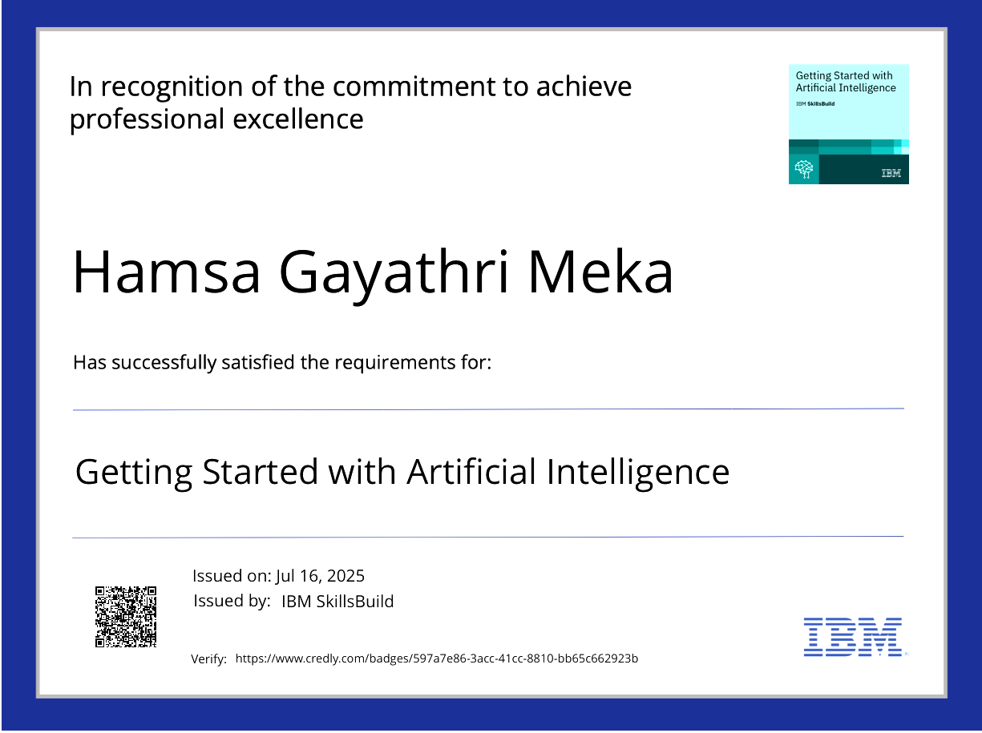
IBM Certifications
Credly certificate( getting started with AI)

Slide 19
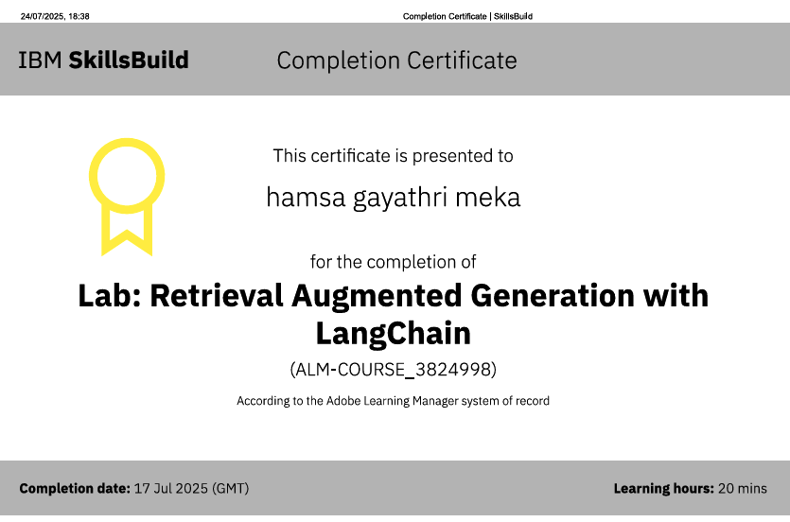
IBM Certifications
Credly certificate( LAB : RAG WITH LANGCHAIN )

Slide 20
THANK YOU

